Slide 1
Natural Language Processing
Gaurav Mapari
Week 1
2026

Slide 2
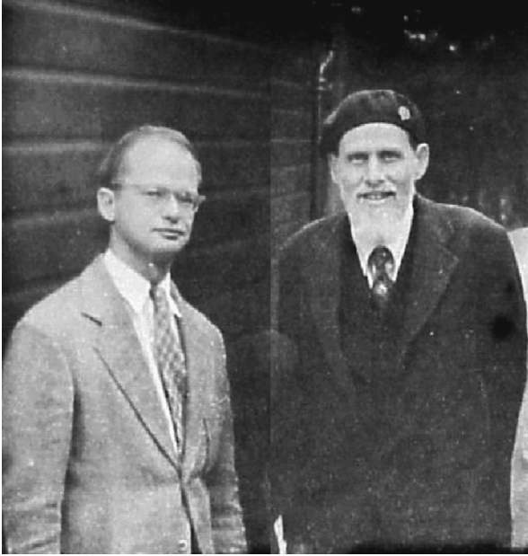
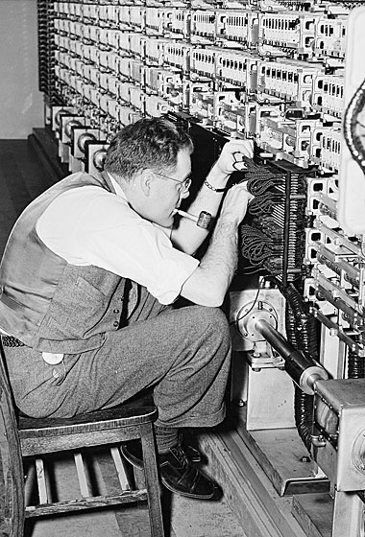
Artificial Intelligence
1943 – McCulloch & Pitts
1950 – Alan Turing
Proposed artificial neuron model
First mathematical model inspired by the human brain.
Turing Test
A benchmark for artificial intelligence where a human evaluator judges natural language conversations between a human and a machine

Slide 3
Artificial Intelligence
Supervised Learning
Unsupervised Learning
Reinforcement Learning
Notes:
We have been chasing AI for more than

Slide 4
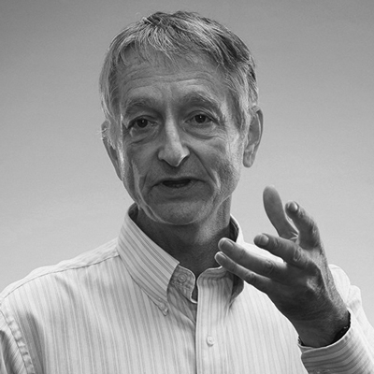
Artificial Intelligence

Slide 5
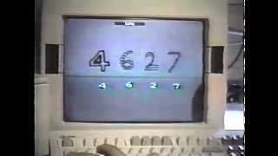
Artificial Intelligence

Slide 6
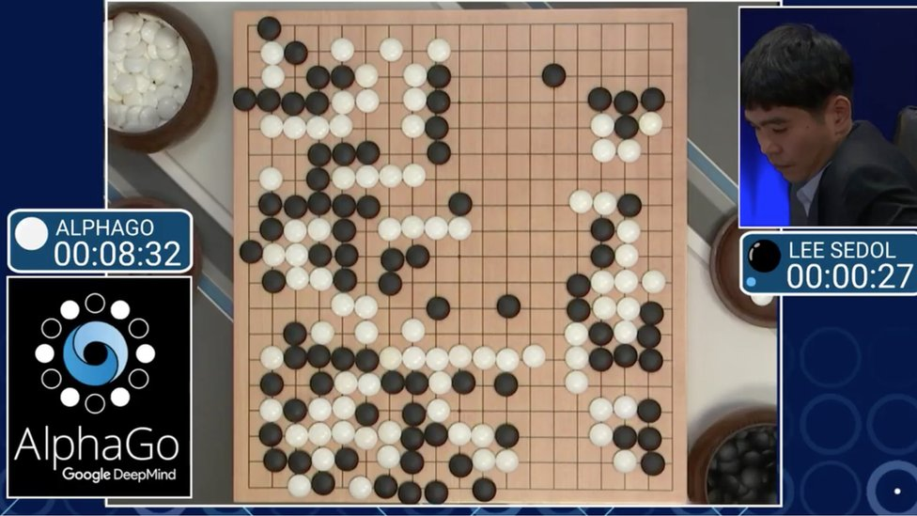
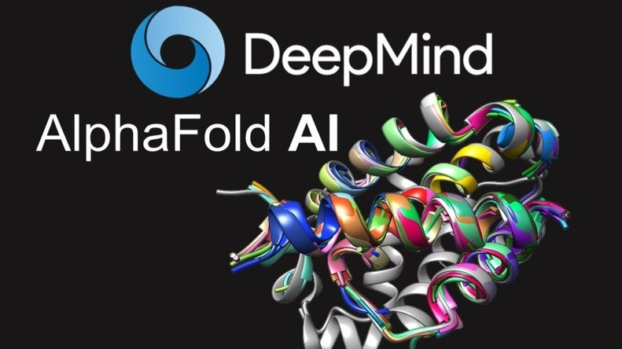
Artificial Intelligence
2016 - Alpha Go beats Lee Sudol
Deep Learning/ RL
2024 - Nobel Prize
Watch Recommendation
The Thinking Game

Slide 7
Artificial Intelligence
All the intelligence till date was task-specific
A model trained for one task was not applicable for other tasks
AI was Narrow
Artificial General Intelligence

Slide 8
Language <-> Intelligence
Shapes thought
Enables reasoning
Preserves and transmits knowledge
Supports learning and collaboration
Language is the tool that allows intelligence to develop, grow, and be expressed.

Slide 9
What is NLP
Technology that enables computers to process, generate, and interact with language (e.g., text). Some key aspects:
Learn useful representations: capture meaning in a structured way that can be used for downstream tasks (e.g.,embeddings used to classify a document)
Generate language: create language (e.g., text, code) for tasks like dialogue, translation, or question answering.
Bridge language and action: Use language to perform tasks,solve problems, interact with environments (e.g., a code IDE)

Slide 10

Today’s NLP

Slide 11
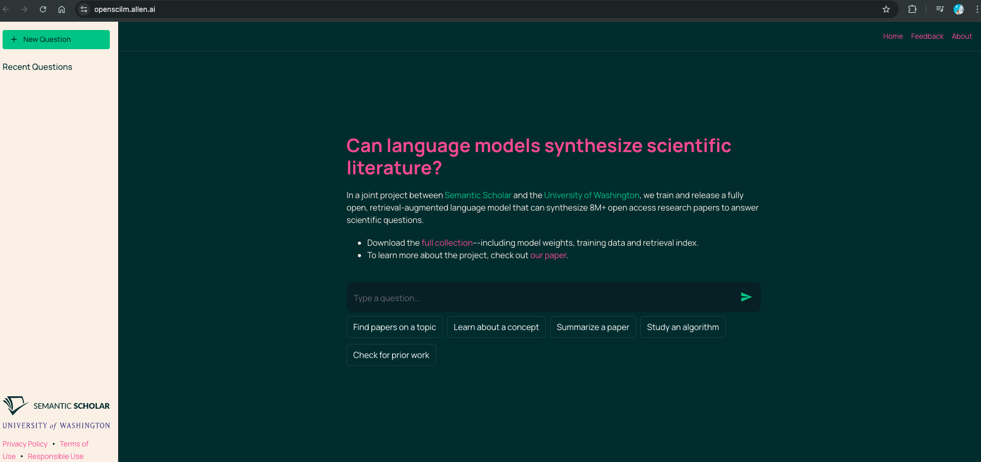
Today’s NLP
https://openscilm.allen.ai/

Slide 12


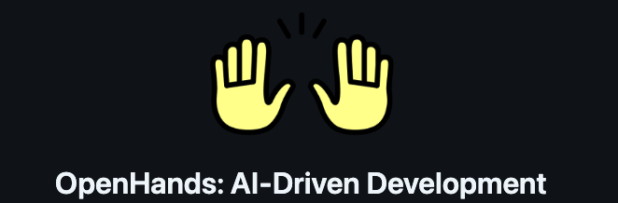
Today’s NLP
https://github.com/OpenHands/OpenHands

Slide 13
In this class, you’ll learn the fundamental concepts and practical techniques underlying systems like these

Slide 14
Broadly: fundamentals -> advanced
Fundamentals of cutting-edge NLP:
Lectures 1 - 14
Advanced topics in cutting-edge NLP:
Lectures 14 - 24

Slide 15
Topic 1: Fundamentals
General framework for NLP
Rule based systems
Pre-processing Techniques
Words and Tokens
Tokenization
Learned Representations
Language modeling
N-gram models

Slide 16
Topic 2: Neural Network Architectures for NLP
Fundamentals
Recurrent Neural Networks
Attention and Transformer
Advanced
Long Sequence Models
Mixture of Experts

Slide 17
Topic 3: Learning and Inference for NLP
Fundamentals
Pre-training
In-context learning
Fine-tuning
Distillation
Advanced
Advanced Inference Strategies

Slide 18
Topic 4: Generative Models for NLP
Fundamentals
Autoregressive models
Retrieval and RAG
Multimodal models
Advanced
Diffusion

Slide 19
Topic 5: Reinforcement Learning and Agents in NLP
Fundamentals
RL basics
RL applications in NLP
Agents

Slide 20
Topic 6: Scaling, Efficiency, and Deployment
Fundamentals
Quantization
Parallel and distributed training
Evaluation techniques

Slide 21
Class format
Wednesday/ Thursday - 8 to 9:30 AM
Mid term / End Term
Assignments (3)
Resources
Github
Assignments
The only book I recommend - here
If you want to be in this field
“Learn how to learn”
Podcasts I recommend - Ilya, Karpathy, Anthropic team

Slide 22
Tasks Performed by NLP Systems
Many tasks involve an input x ∈ 𝒳 and an output y ∈ 𝒴, where x and/or y might involve language.
Input x | Output y | Task
Text | Label | Text Classification
Text | Text in other language | Translation
Image | Text | Image Captioning
Search Query | List of documents/ webpages | Retrieval
State of an environment | Action | Decision making Agent Tasks

Slide 23
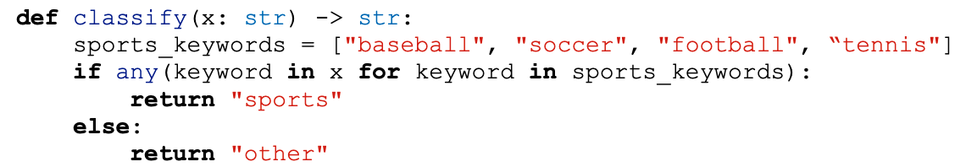
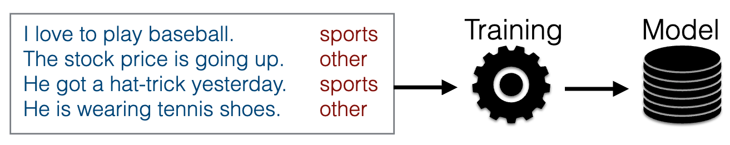
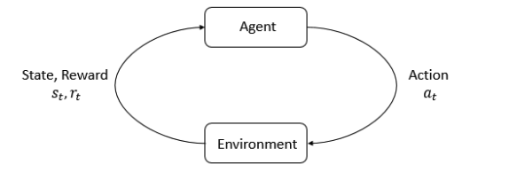
A Few Methods for Creating NLP Systems
Rules:
Manual creation of rules
Supervised learning:
Machine learning from data
Reinforcement Learning:
Learning to maximize reward by interacting with an environment

Slide 24
Data Requirements for System Building
Rules/prompting based on intuition:
No data needed, but also no performance guarantees
Rules/prompting based on spot-checks:
A small amount of data with input x only
Supervised learning:
Additional training set. More is often better
Reinforcement learning:
An environment (inputs, states/actions/transitions, reward)

Slide 25
Building a rule-based NLP system

Slide 26
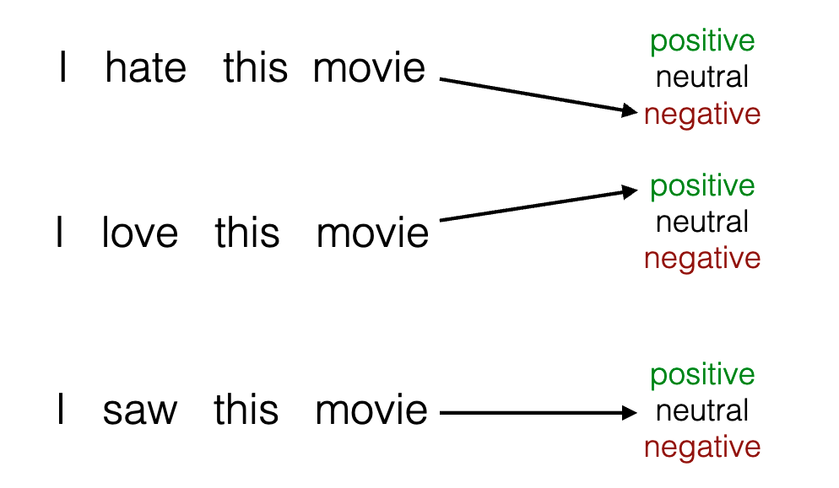
Goal: Design a Classifier
Given a review on a reviewing website (x), decide whether
its label (y) is positive (1), negative (-1) or neutral (0)

Slide 27
Goal: Design a Classifier
g : 𝒳 → 𝒴
x ∈ 𝒳: input sentence
y ∈ 𝒴 : {-1,0,1}
We are given a dataset D = {(𝒳_{i}, 𝒴_{i})} _{i=1}^{N}

Slide 28
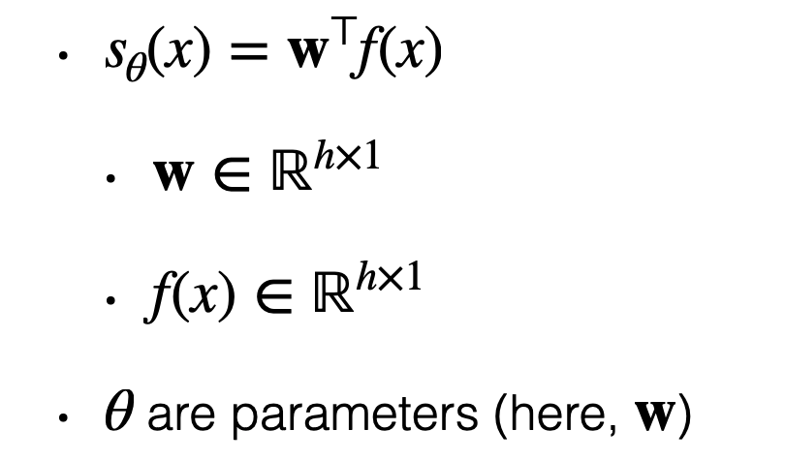
General Pattern: Features and Score
Extract a feature vector f(x), and compute a score:

Slide 29
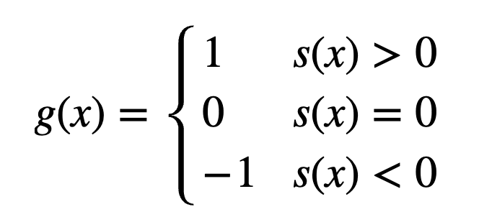
Making a decision
Decide which class 𝒳 belongs to using the scoring function:

Slide 30
Three general ingredients
Parameterization: choose how the scoring function is computed and which parameters (e.g., numbers or rules) need to be set.
Learning: setting the parameters based on data.
Inference: make a decision given a scoring function.

Slide 31
Code Exercise

Slide 32
Why NLP is hard?

Slide 33
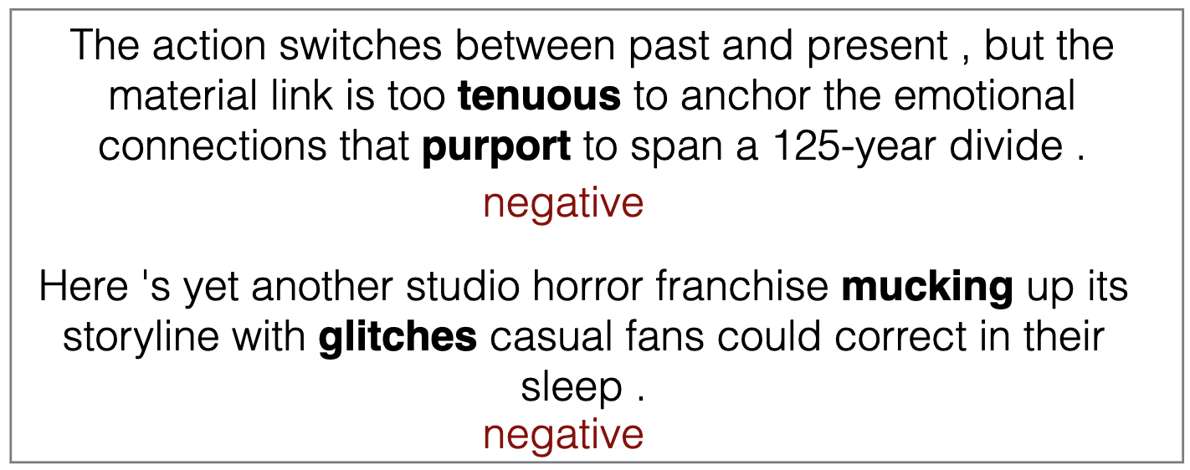
Low-frequency Words
Solution?: Keep working until we get all of them? Incorporate external resources such as sentiment dictionaries?

Slide 34
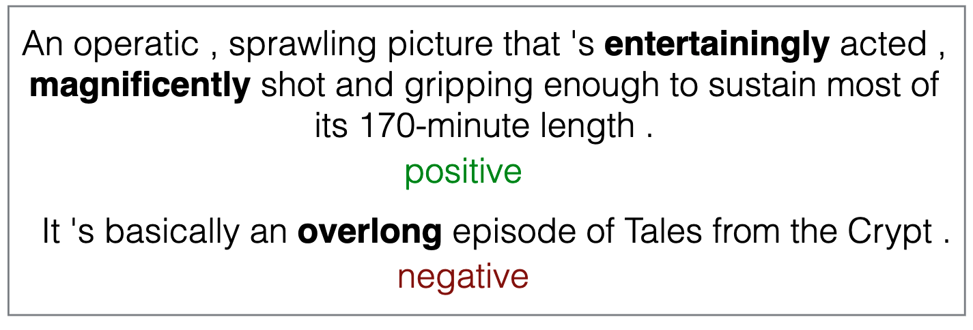
Conjugation
Solution?: Use the root form and part-of-speech of word?

Slide 35
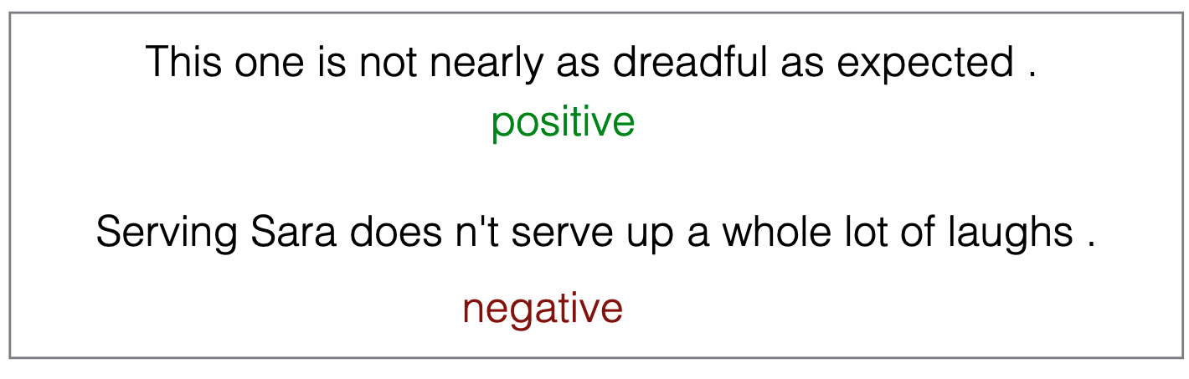
Negation
Solution?: If a negation modifies a word, disregard it?

Slide 36
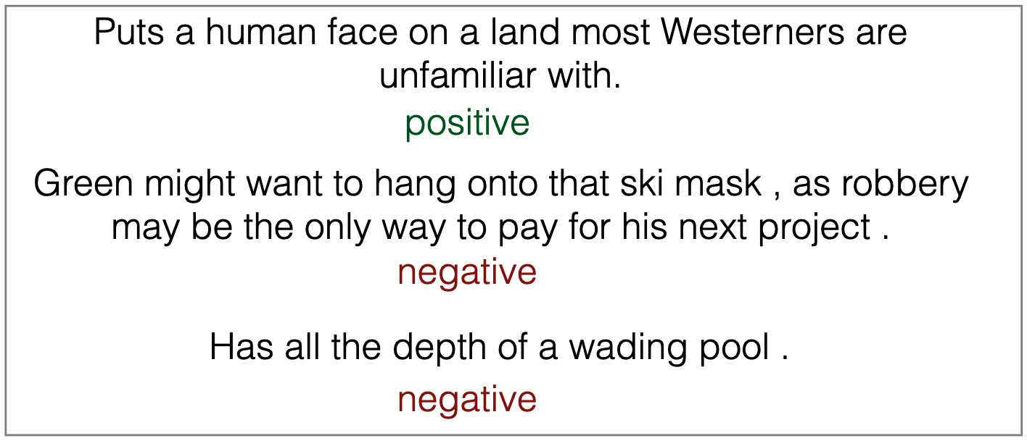
Metaphor, Analogy
Solution?: ???

Slide 37
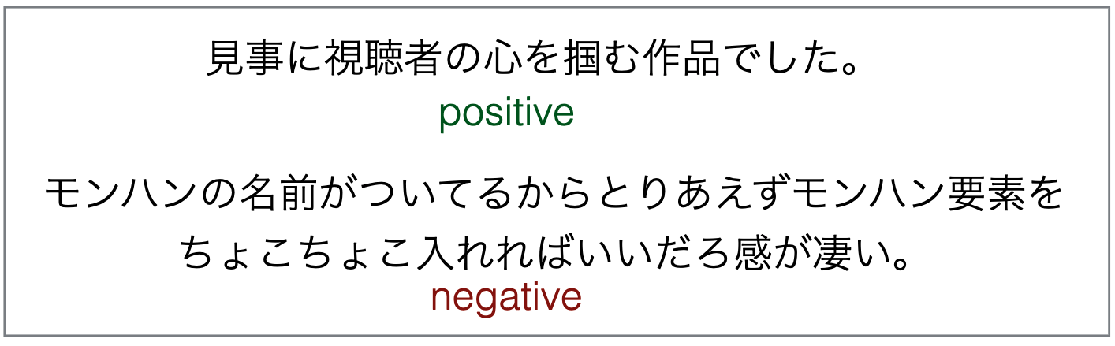
Other Languages
Solution?: Learn Japanese and redo all the work

Slide 38
Questions ?

Slide 39
Learning the Scoring Function

Slide 40
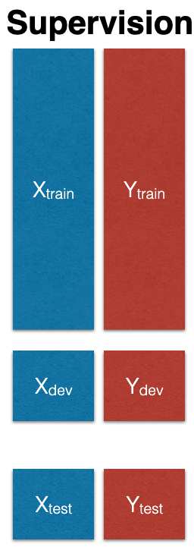
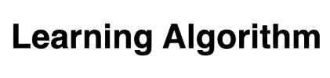
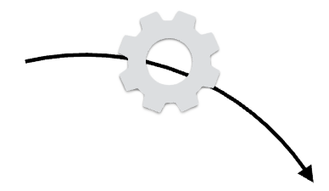
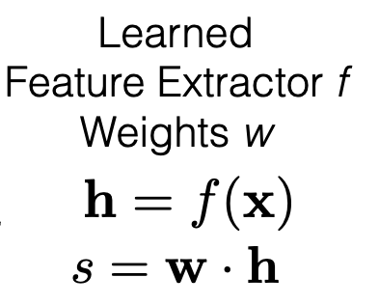
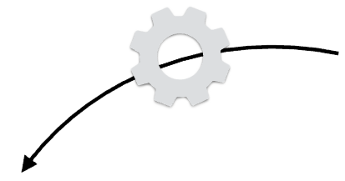
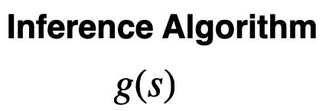
Learning the scoring function

Slide 41
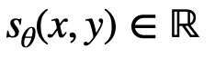
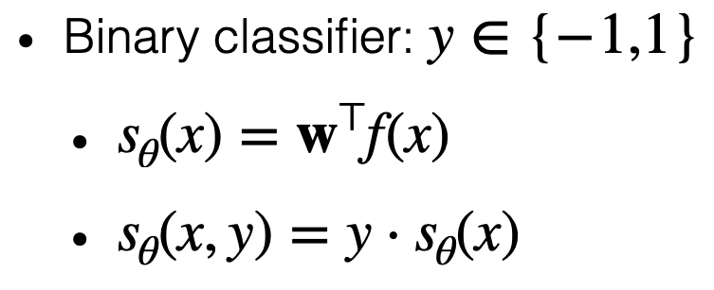
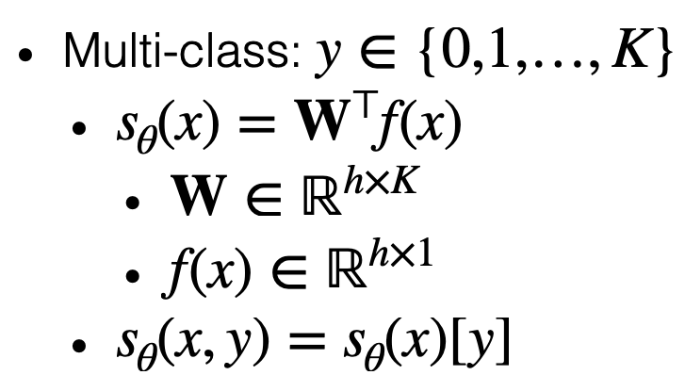
A more general recipe
• Goal: Learn a scoring function (“energy function”) that says how compatible output y is for input x
Higher score: more compatible.
Lower score : less compatible.
*The (negative) score is also referred to as an “energy” E(x, y) = − s(x, y)

Slide 42
Three general ingredients
Goal: Learn a scoring function (“energy function”) that says how compatible output is for input :
Parameterization: choose how the scoring function is computed and which parameters (e.g., numbers or rules) need to be set
(e.g., neural net architecture and its weights)
Learning: setting the parameters based on data.
(e.g., neural net architecture and its weights)
Inference: make a decision given a scoring function

Slide 43
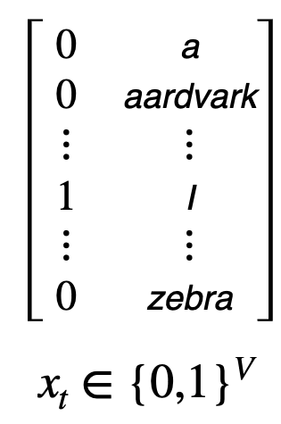
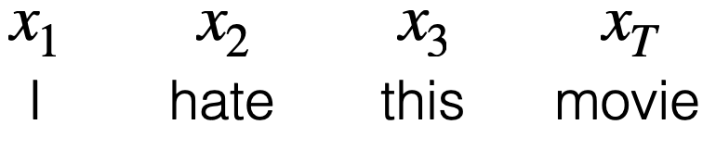
Example Parametrization: Bag of Words (BoW)
Score s ∈ ℝ
Weights w ∈ ℝV
Features f(x) ∈ ℝ
V: Vocabulary size
(e.g., set of all words in training set)
lookup
lookup
lookup
lookup

Slide 44
Example Parametrization: Bag of Words (BoW)
Score s ∈ ℝ
Weights w ∈ ℝV
Features f(x) ∈ ℝ
lookup
lookup
lookup
lookup
Features f are based on word identity, weights w learned
Which problems mentioned before would this solve?

Slide 45
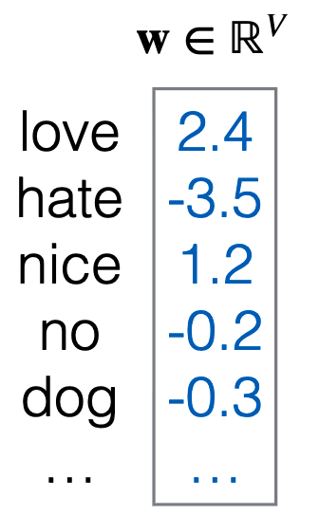
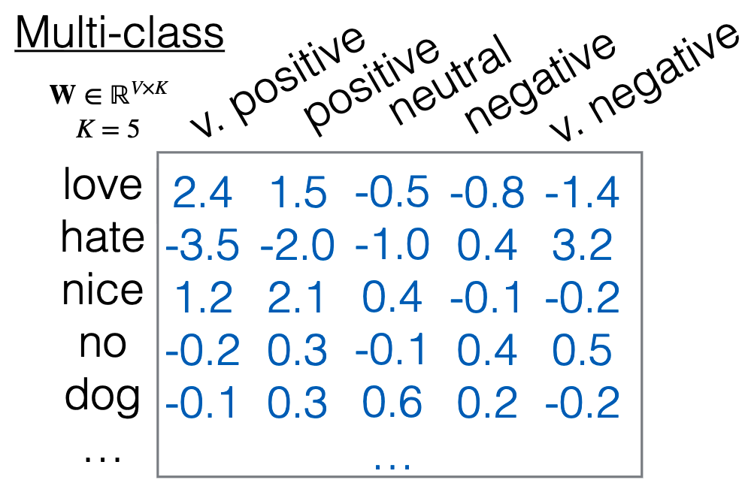
What do the parameters represent?
Binary classification
Each word has a single scalar, positive indicating “positive” and negative indicating “negative”
Multi-class classification
Each word has its own 5 elements corresponding to e.g. [very pos, pos, neutral, neg, very neg]

Slide 46
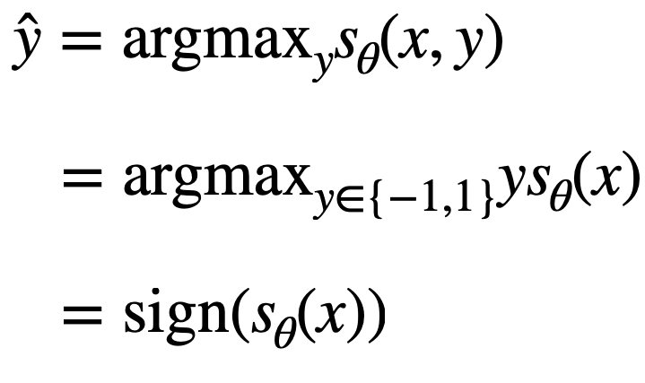
Example inference
• Example for a binary classifier:
E.g., the output scalar from the bag-of-words model on the previous slide

Slide 47
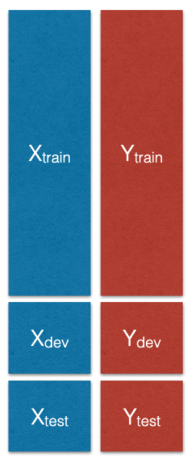
Example Learning
Given examples (x,y) split into:
D_{train}, D_{dev} and D_{test}
Define a Loss Function
ℒ(θ, D) = ∑_{(x,y)∈D} L(x, y, θ)
Run an algorithm that solves:
min_{θ}ℒ(θ, D_{train})

Slide 48
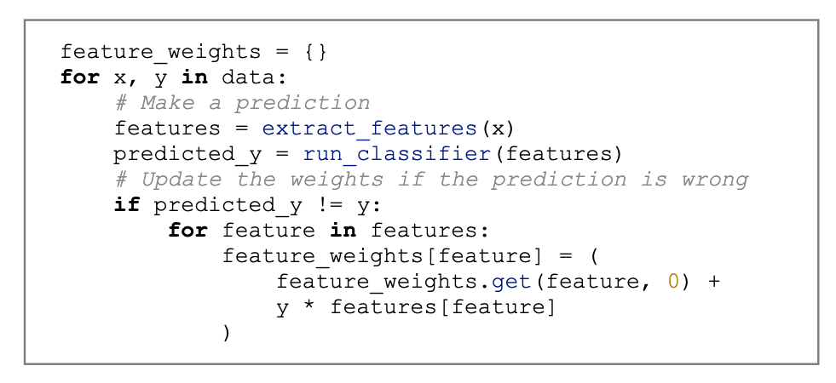
Example Learning - Structured Perceptron

Slide 49
What’s Missing?
Handling of conjugated or compound words
I love this movie -> I loved this movie
Handling of word similarity
I love this move -> I adore this movie
Handling of sentence structure
It has an interesting story, but is boring overall
...

Slide 50
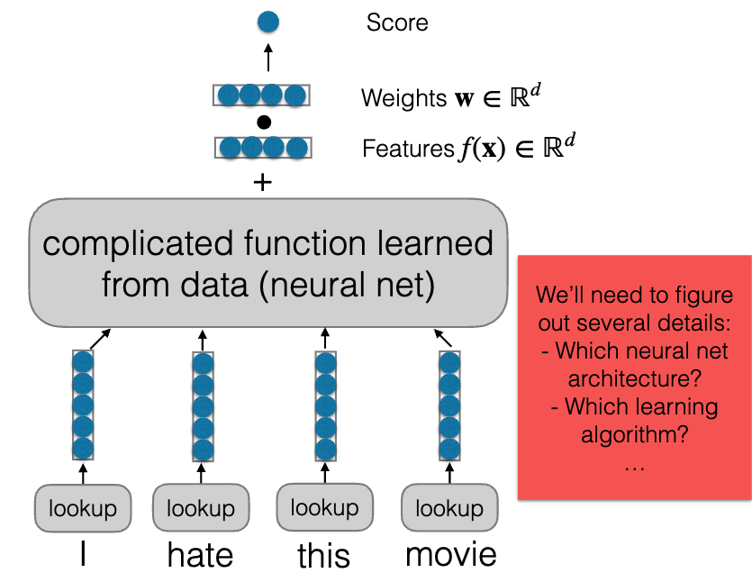
A Better Parameterization:Neural Networks

Slide 51
From classification to general tasks

Slide 52
A General Recipe
Build a parameterized scoring function (“energy function”) that says how compatible output y is for input x:
s_{θ}(x, y) ∈ ℝ
Parameterization: choose form of s_{θ} and the parameters to set
Learn the parameters using supervision (e.g., labels, rewards)
Inference: select an output (e.g., maximization, sampling)
ŷ = g(s, x)

Slide 53
A General Recipe
Classification: assign high scores to correct classes, low scores to incorrect classes
Ranking: given a query x, assign scores to documents y₁ , y₂ , … so that they’re in the correct order
Probabilistic modeling: assign scores so that we have a distribution
p(y|x)
Example:
x : English sentence, y : Japanese sentence
x : Conversation history, y : response

Slide 54
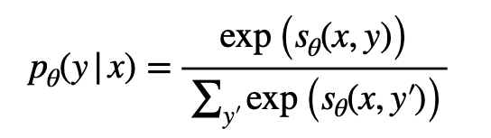
From scores to probabilities
Given a scoring function, we can build a probabilistic model:
For instance:
I hate this movie ->[negative = 0.98, neutral = 0.01, positive = 0.01]
With a probabilistic model we can do inference by sampling:
ŷ ∼ pθ(y | x)

Slide 55
From classification to generation
Now suppose the output space is any sequence (of text,images, etc.):
I hate this movie ->[negative = 0.98, neutral = 0.01, positive = 0.01]
We can generate text, images, or make decisions by sampling
Example: large language models
We’ll cover the parameterization, learning, and inference for achieving this!

Slide 56
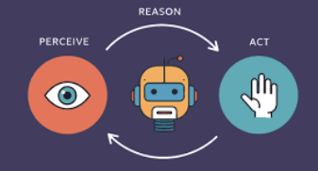
From generation to actions
We can use such a model to form a “policy” a that is used to decide which action to take in state S :
S: {Movie streaming website}
The user said: “I hate this movie”
A: [CLICK]pause button

